Slide 1
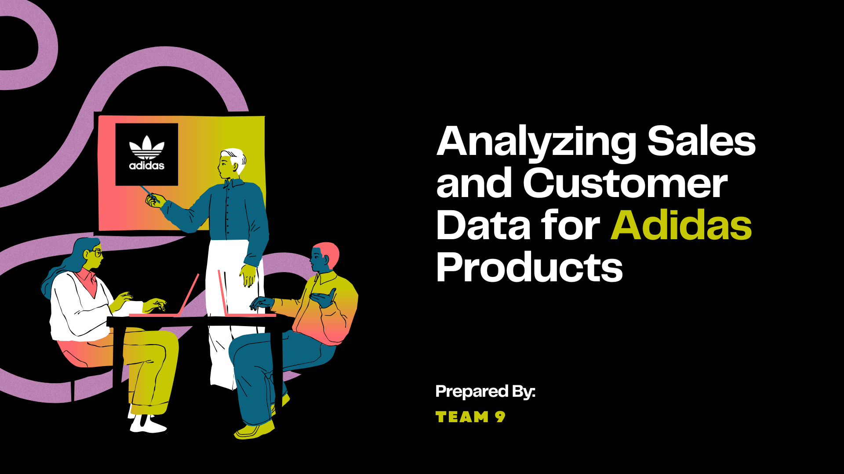

Slide 2
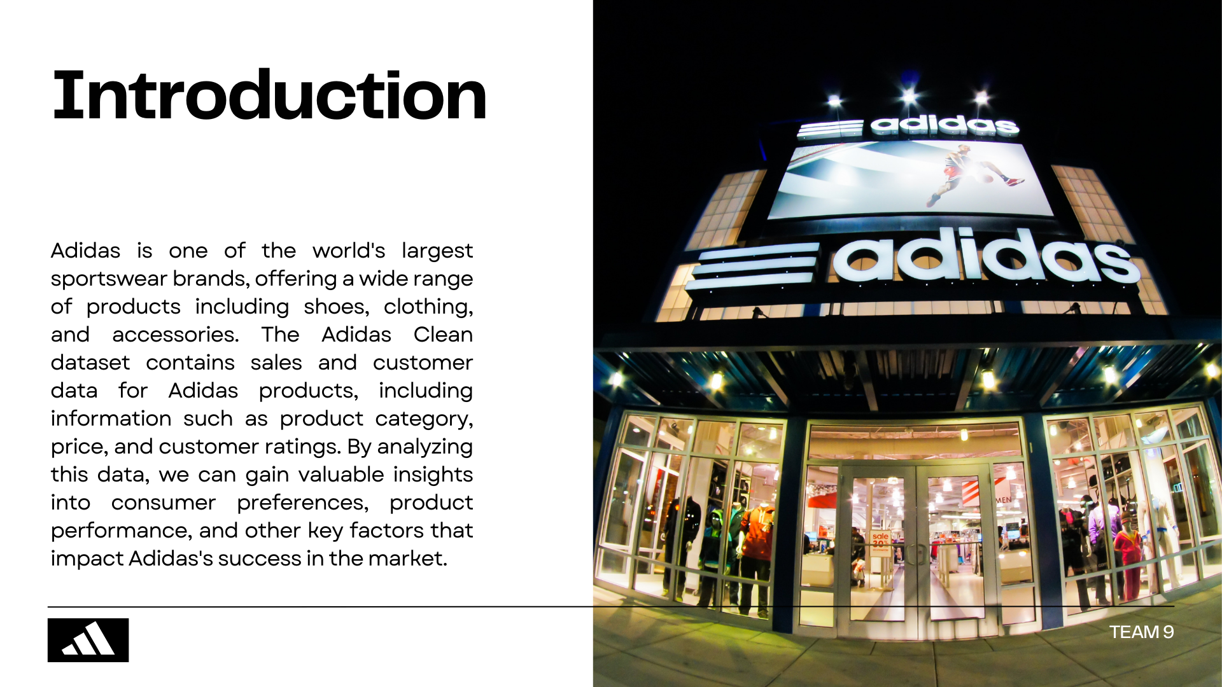

Slide 3
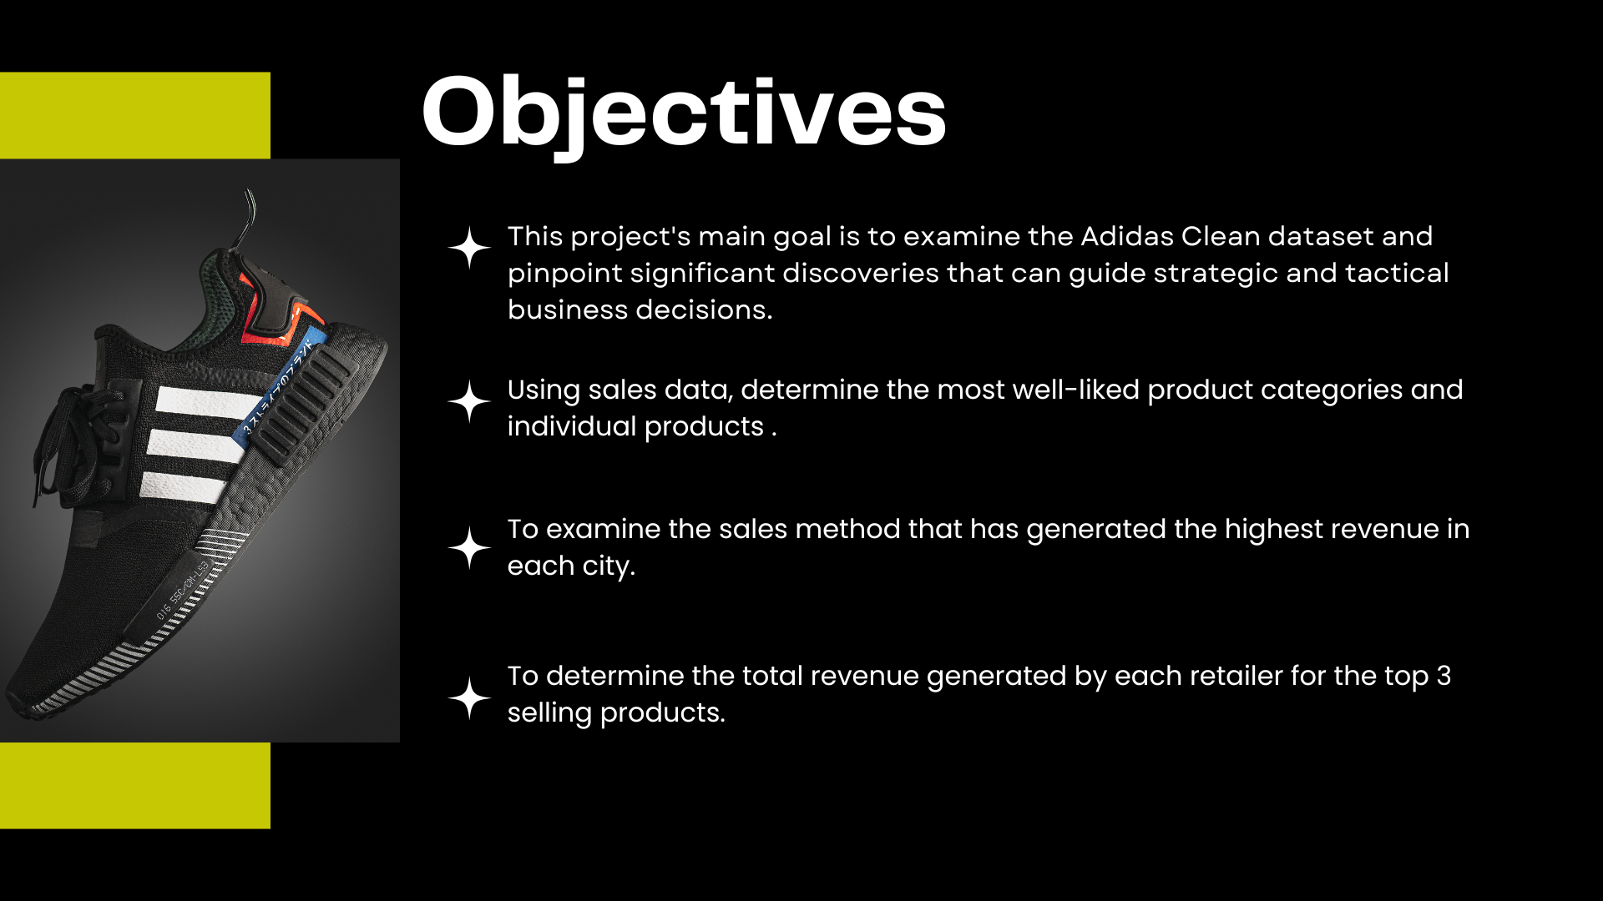

Slide 4
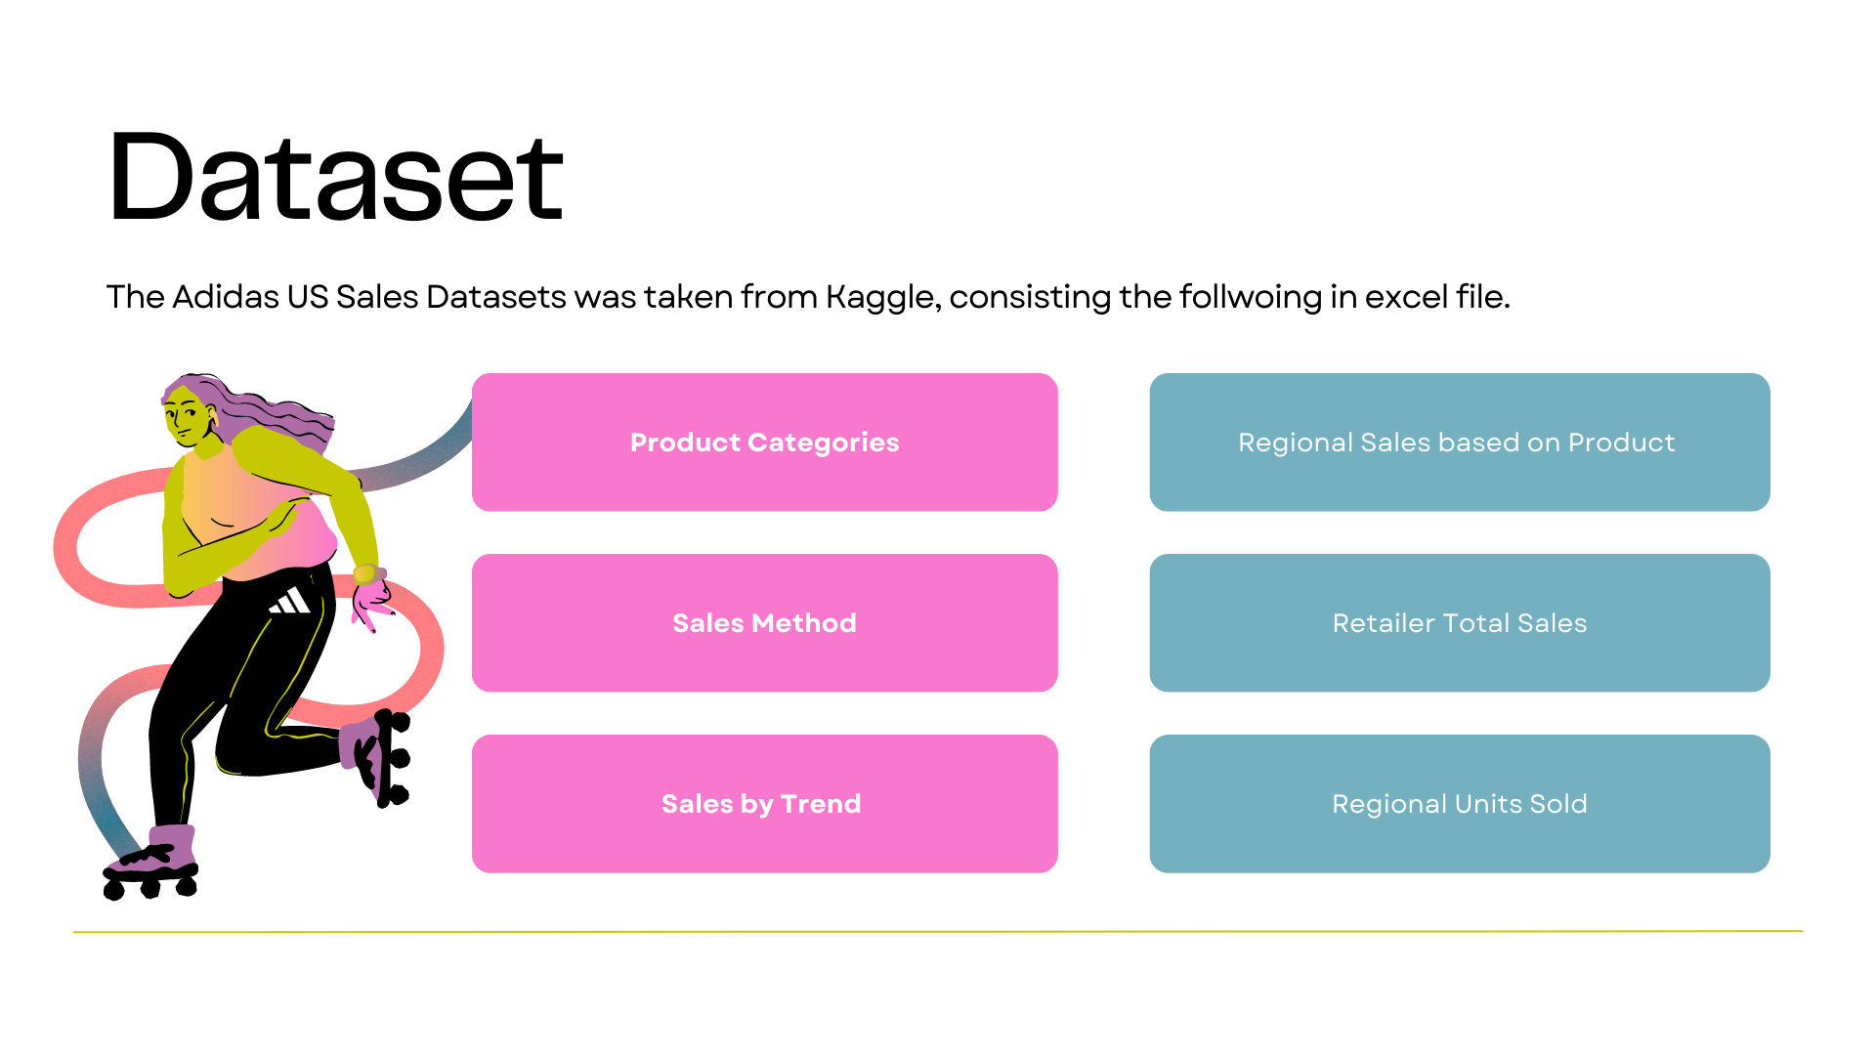
Dataset Information

Slide 5
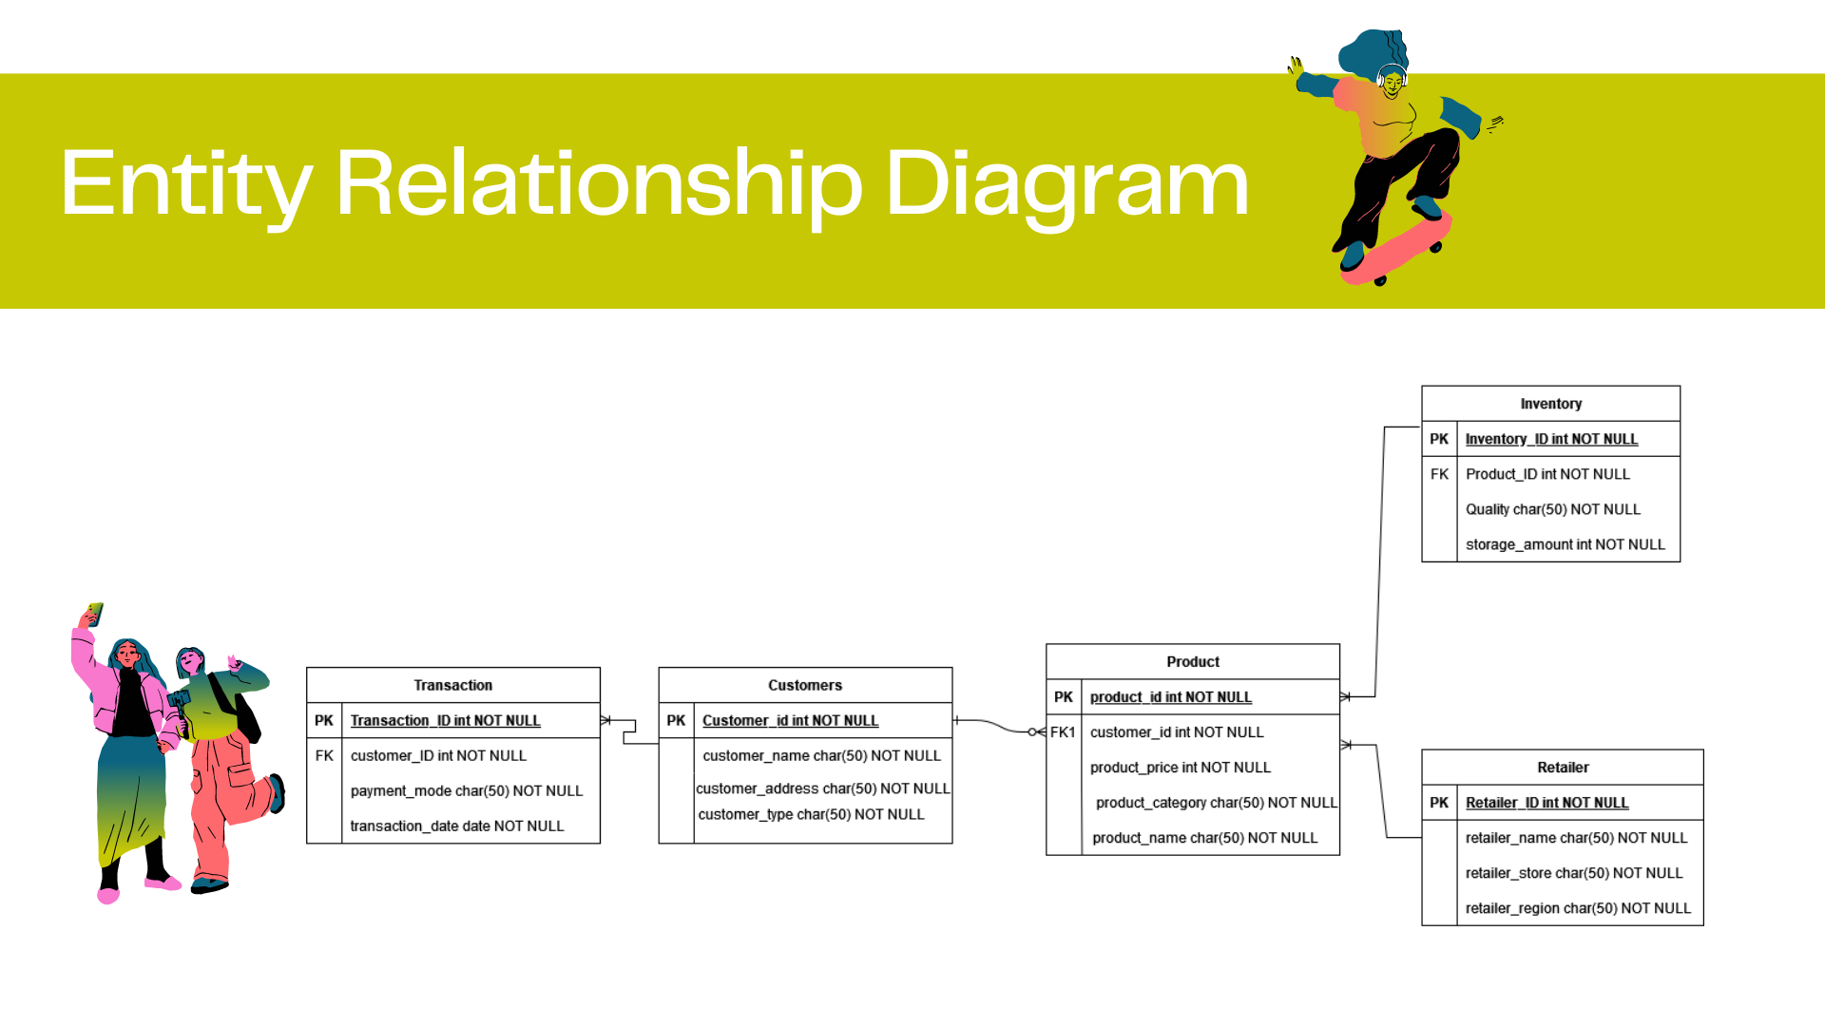

Slide 6
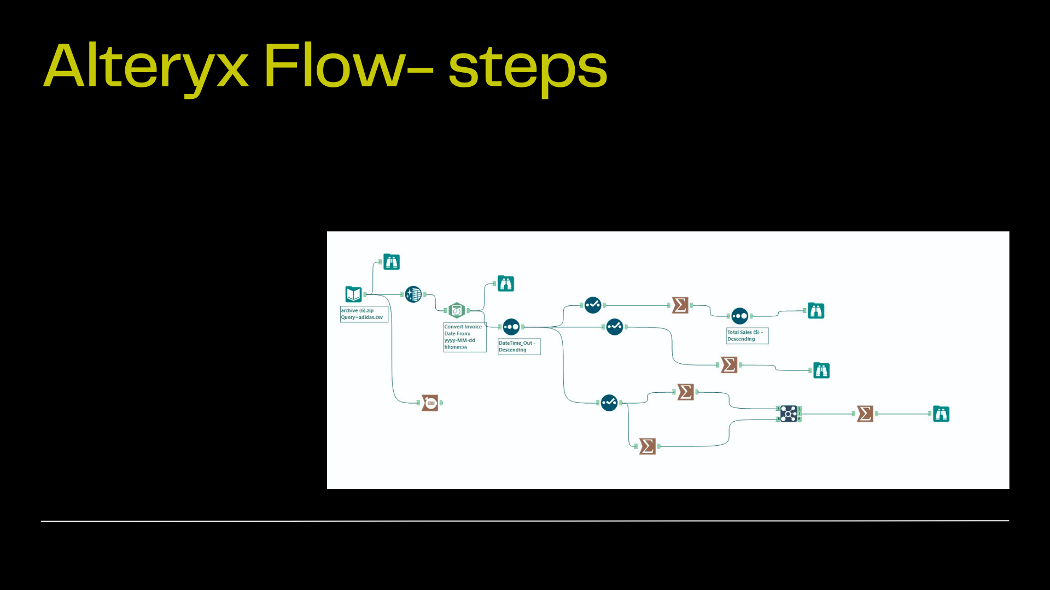
Alteryx is a data analytics and workflow automation tool that allows users to blend, clean, and analyze data from multiple sources
Alteryx flow steps include inputting data, selecting, filtering,sorting, summarizing, joining, creating formulas, and outputting data. There are also tools for data preparation, spatial data, and integration with other software platforms.

Slide 7
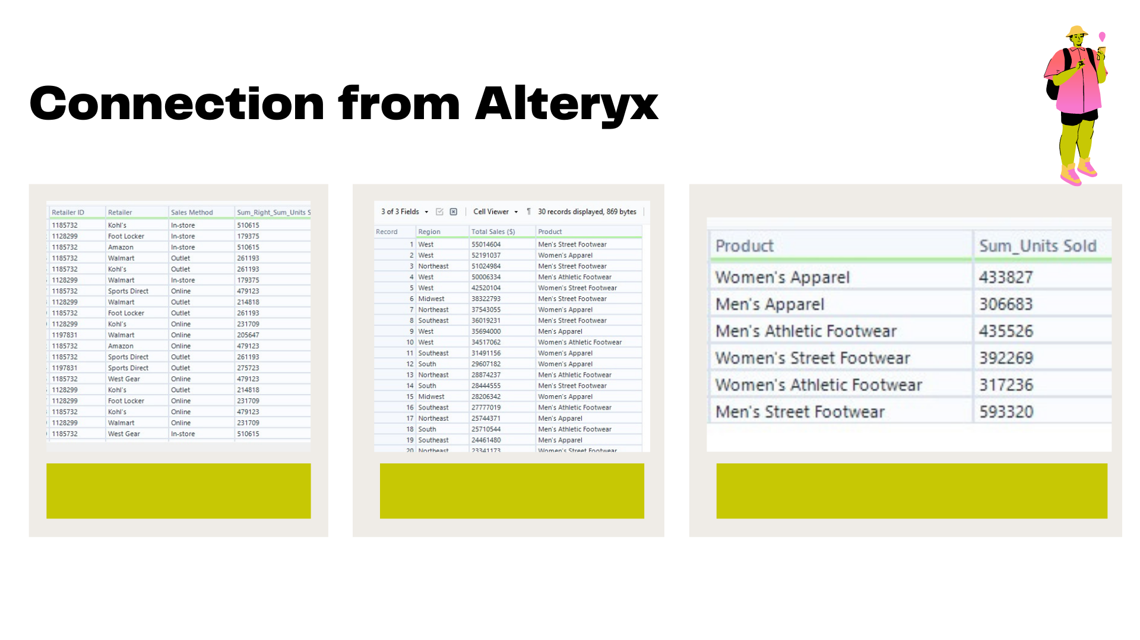

Slide 8
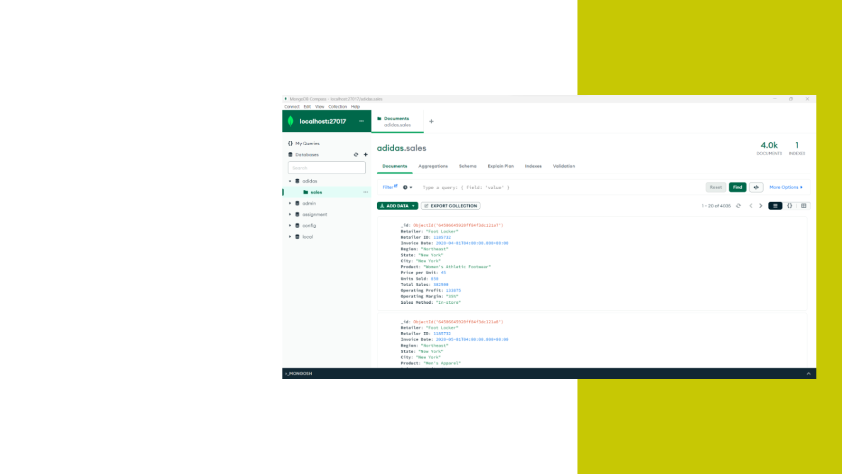
MongoDB File
Imported the data set with 4035 records to mongoDB
Database name- Adidas
Collection name- sales

Slide 9
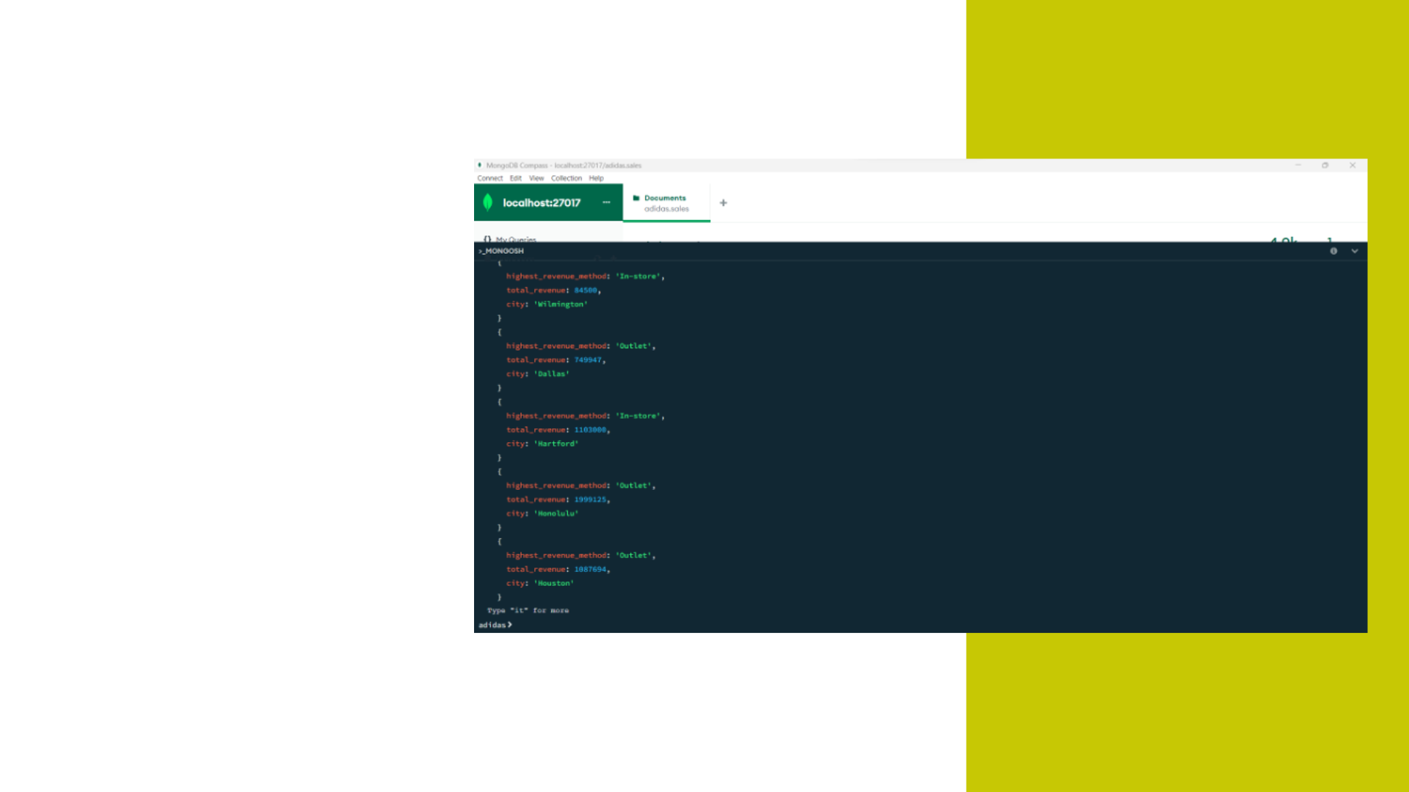
Sales method has generated the highest revenue in each city

Slide 10

Total revenue generated by each retailer for the top 3 selling products

Slide 11
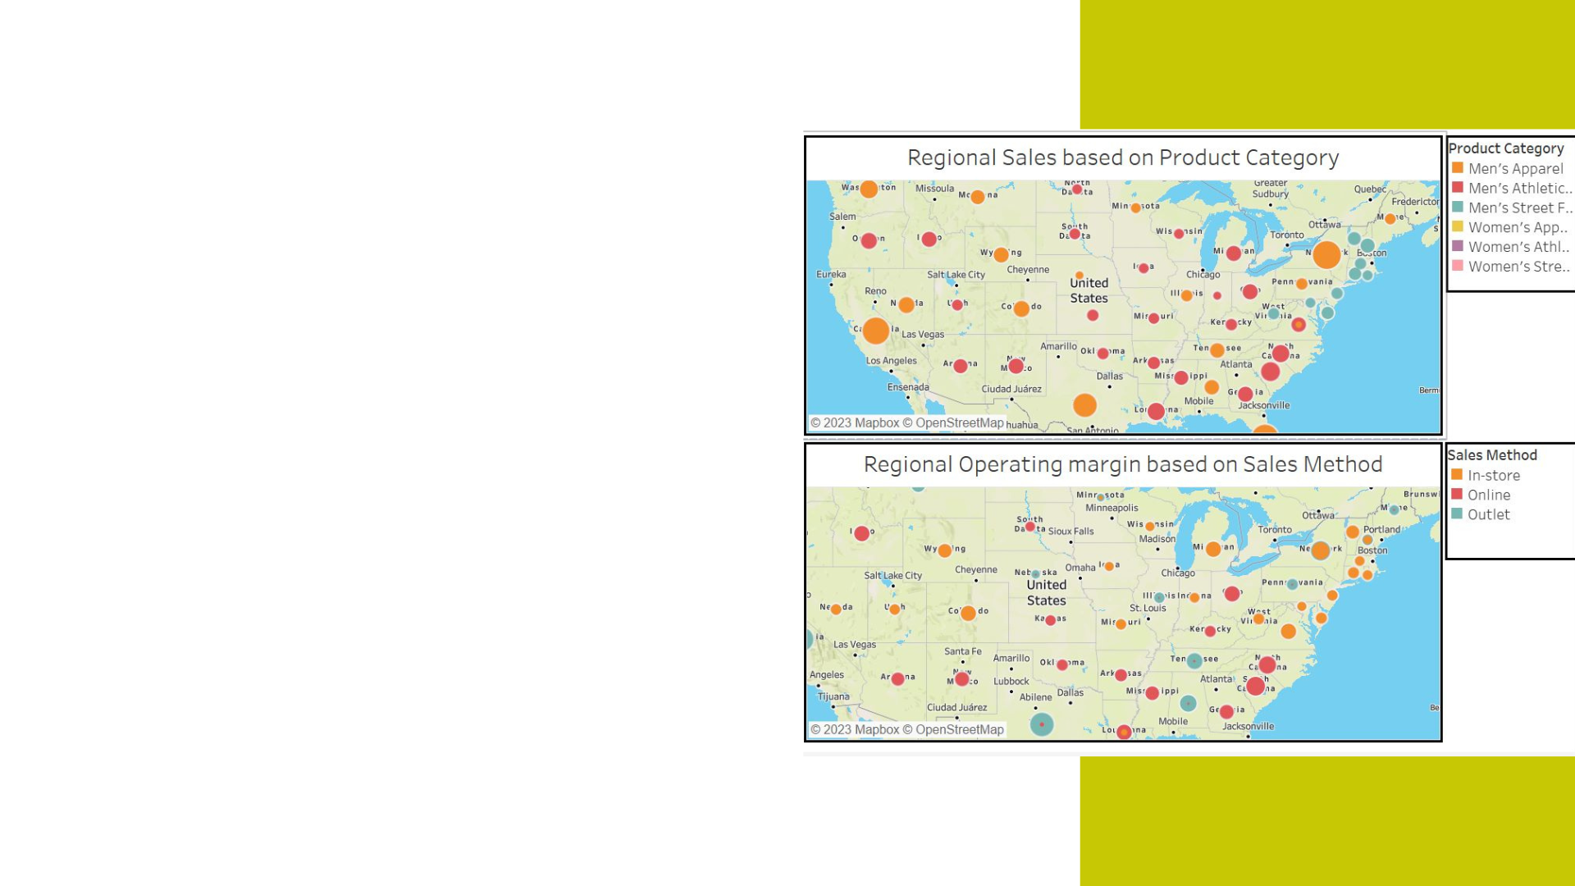
Purpose:
Regional sales based on Category and Sales Method
Graph explanation:
Geographic Graph
Colours representation
Insights:
Major Sales - Men’s Apparel
Highest Sales with respect to method - In-store

Slide 12
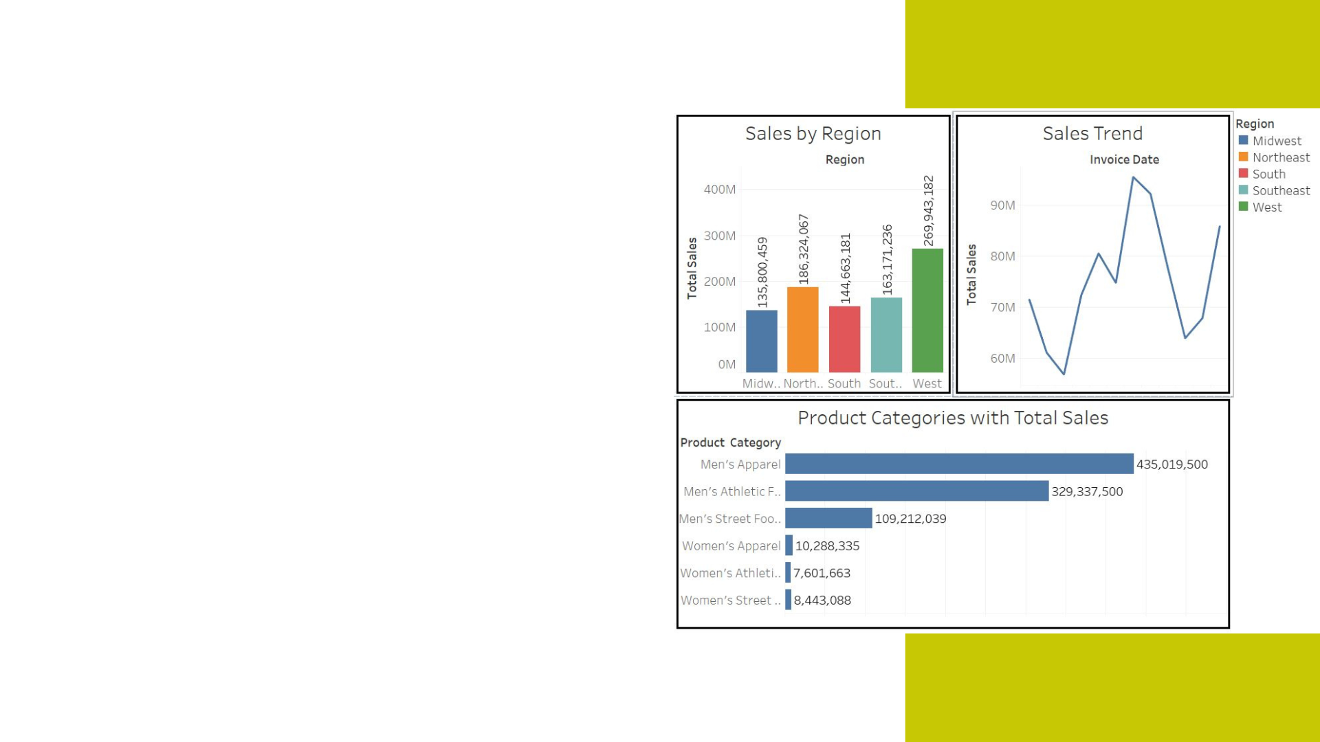
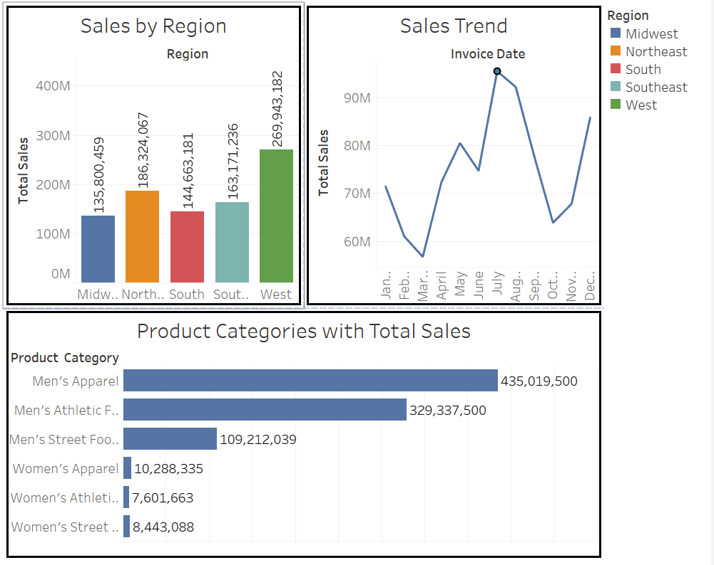
Purpose:
Sales by region
Monthly Sales trent
Total Sales by product category
Graph explanation:
Bar graph and Line chart
Insights:
West region has highest sales
Highest sales in July
Highest selling category - Men’s Apparel

Slide 13


